Slide 1
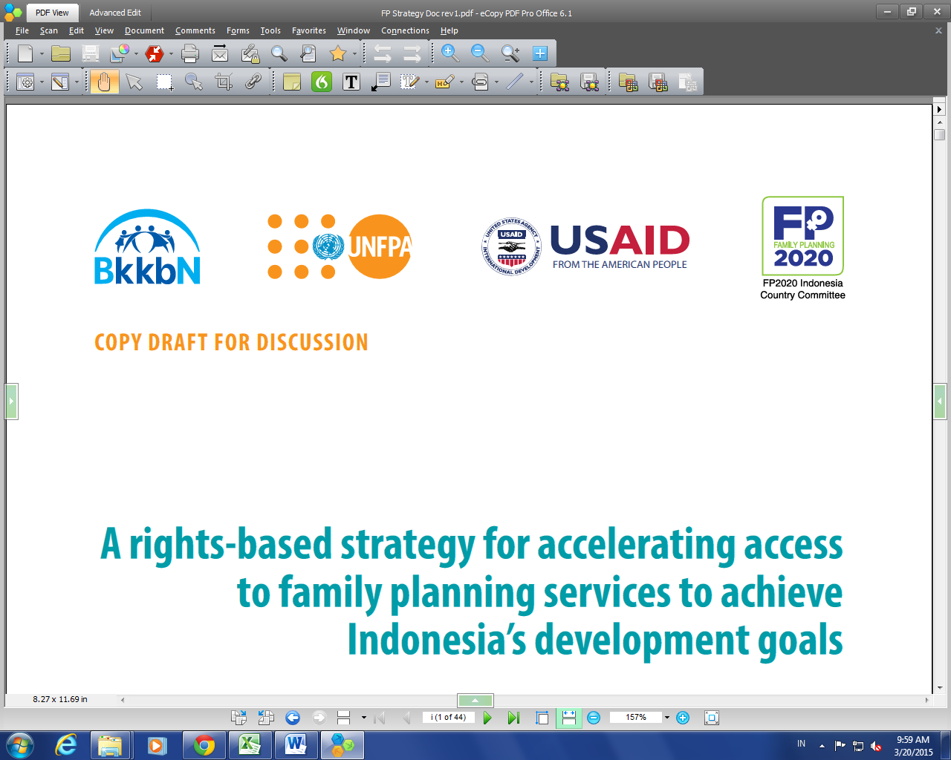
Title: A rights-based strategy for accelerating access to Family Planning services to achieve developmental goals of Indonesia
Developed by FP strategy working group with inputs from rights and empowerment group and with technical assistance from UNFPA
March 20, 2015

Slide 2
Outline of presentation
Vision, mission, goals and strategic outcomes
Guiding principles
Strategic outcomes and outputs
Suggested list of performance indicators
Next steps

Slide 3
The strategy context
RPJMN 2015-2019
MOH Renstra
FP strategy
BKKBN Renstra
Local Government through Ministry of Home Affairs

Slide 4
Vision, Mission, Goal
Vision (to be aligned to RPJMN 2015-2019 and BKKBN vision, MOH action plan, MDG and post-MDG targets)
Mission
To catalyse collective action between BKKBN, MOH, BPJS, NGOs, private sector partners, professional associations, donor agencies and local governments to achieve universal access to high quality family planning services according to the needs of individuals and couples and to meet their reproductive intentions.
Goal
To contribute to reduced maternal mortality, population growth and fertility rate by addressing unmet needs, removing barriers to access and improving the quality of services

Slide 5
RPJMN targets 2015-2019
Indicator | Target (as of June 2014)
Maternal mortality ratio | 309
Annual growth rate (%) | 1.19
Total fertility rate | 2.3
Adolescent fertility rate | 35
Contraceptive prevalence rate (%) | Total: 66 Modern: 61.5 (BKKBN)
Proportion of long acting and permanent methods as proportion of modern methods (%) | 23.5
Unmet need (%) | 9.9

Slide 6
Strategic Outcomes
Overall objective of the strategy: To provide guidance for quality assurance, stewardship and demand creation to help translate the commitments made by the Government at FP 2020 meeting, as part of the MDGs and under the post-2015 development agenda
Strategic Outcome 1: Equitable and quality FP service delivery system sustained in public and private sector to enable all to meet their reproductive goals
Strategic Outcome 2: Increased demand for modern methods of contraception met with sustained use
Strategic Outcome 3: Enhanced stewardship / governance at all levels of and strengthened enabling environment for effective, equitable and sustainable FP programming in public and private sector to enable all to meet their reproductive goals
Strategic Outcome 4: Fostered and applied innovations and operations research for improving efficiency and effectiveness of programmes and for sharing through south-south collaboration

Slide 7
Areas of alignment with RPJMN Strategic issues
FP strategy (proposed strategic objectives | RPJMN strategic issues related to FP (Source: BAPPENAS)
Strategic outcome 1: Equitable and quality FP service delivery system sustained in public and private sector to enable all to meet their reproductive goals | Strategic Issue 2: Improving access to and quality of FP services
 | Strategic Issue 3: Increase the understanding and awareness of adolescents regarding reproductive health and preparation for family life
 | Strategic Issue 7: strengthening data and information
Strategic outcome 2: Increased demand for modern methods of contraception met with sustained use | Linked to Strategic Issues 1 and 3 Strategic Issue 4: Family development
Strategic outcome 3: Enhanced stewardship of and strengthened enabling environment for effective, equitable and sustainable FP programming in public and private sector to enable all to meet their reproductive goals | Strategic Issue 1: Strengthen advocacy for FP, reproductive health and family formulation
 | Strategic Issue 5: Strengthening the legal foundation and the policy on population and FP
 | Strategic Issue 6: Strengthening the institution of FP
Strategic outcome 4: Fostered and applied innovations and operations research for improving efficiency and effectiveness of programmes and for sharing through south-south collaboration
M&E: Indicators for each output | Targets and indicators specified under each strategic issue
 | FRAMEWORK: Regulatory framework, Financing framework, Institutional framework

Slide 8
Areas of alignment with MOH FP Action Plan 2014-15
FP strategy (proposed strategic objectives) | MOH action plan for FP
Strategic outcome 1: Equitable and quality FP service delivery system sustained in public and private sector to enable all to meet their reproductive goals | Strategy 2: To increase availability, affordability, and quality of family planning services, including IEC and counselling services
 | Strategy 4: To reduce the unmet need by improving access, counselling, and to strengthen postpartum use of contraceptives as well as decreasing the reluctance to continually use contraceptives, through increased use of LA/PM (MKJP) and family planning coaching
 | Strategy 5: To lower the rate of pregnancy among teens aged 15-19 years old by encouraging them to get married at older age and improving their knowledge of Adolescent Reproductive Health
Strategic outcome 2: Increased demand for modern methods of contraception met with sustained use | Strategy 3: To increase the demand for family planning service due to changes in values regarding the ideal number of children in the family
Strategic outcome 3 Enhanced stewardship of and strengthened enabling environment for effective, equitable and sustainable FP programming in public and private sector to enable all to meet their reproductive goals | Strategy 1: To strengthen the commitment of stakeholders, both the government and non-government, in organizing family planning services
Strategic outcome 4: Fostered and applied innovations and operations research for improving efficiency and effectiveness of programmes and for sharing through south-south collaboration
M&E- indicators for each output | M&E – Indicators for activities

Slide 9
Guiding principles
Right o access to FP information and highest standard of care
Equity in access
Health systems approach:
Integration of FP across the continuum of care across reproductive cycle
Ethical and professional standards in the delivery of FP services
Evidence-based programming
Transparency and accountability
Gender sensitive services
Cultural sensitivity
Partnership including public- private

Slide 10
Strategic outcome 1: Equitable and quality FP service delivery system sustained in public and private sector to enable all to meet their reproductive goals.
The strategic objective is built on the building blocks of the health system. There are six outputs which are interlinked.
Outputs:
Output 1.1: Increased availability of FP services, with improved and equitable access in the public sector, to enable all to meet their reproductive goals.
Output 1.2: Private sector resources harnessed for equitable access to quality FP services with attention to client rights
Output 1.3: Improved contraceptive commodity security system with no stock outs
Output 1.4: Improved capacity of human resources to deliver quality FP services
Output 1.5: Strengthened management information system ensuring quality, completeness and alignment integration with health system
Output 1.6: Improved quality of FP services with attention to client rights and integration of services across the continuum of reproductive cycle

Slide 11
Strategic outcome 2: Increased demand for modern methods of contraception met with sustained use
Outputs
Output 2.1: Availability of a comprehensive BCC strategy
Output 2.2: Increased involvement of health workers, women’s groups and religious leaders in mobilizing support for FP and addressing barriers to FP as well as equity issues

Slide 12
Strategic outcome 3: Enhanced stewardship of and strengthened enabling environment for effective, equitable and sustainable FP programming in public and private sector to enable all to meet their reproductive goals
Output 3.1: Enhanced capacity for stewardship within and between sectors at BKBN and provincial level BKKBN for efficient and sustainable programming
Output 3.2: Strengthened coordination with MOH at central, provincial and district levels for strengthening health system contribution to FP at appropriate points in reproductive life cycle
Output 3.3: Enhanced leadership and capacity of SKPD KB Director and District Health Managers to effectively manage the FP programme
Output 3.4: Enhanced capacity for evidence-based advocacy at all levels of Government and community focusing on the centrality of FP in achieving MDGs for increased visibility of FP programmes and leveraging resources
Output 3.5: Strengthened capacity for evidence- based policies that improve the effectiveness of FP programme while ensuring equity and sustainability
Output 3.6: Functional accountability systems in place that involves civil society.

Slide 13
Strategic Outcome 4: Fostered and applied innovations and operations research for improving efficiency and effectiveness of programmes and for sharing through south-south collaboration
Output 4.1: Best practices and models available for promoting South-South collaboration
Output 4.2: Operations research for improving efficiency and effectiveness of FP programmes are applied, evaluated and scaled up as indicated

Slide 14
Proposed list of indicators
Outcomes and outputs | Performance indicators (proposed)
Strategic outcome 1 | Proportion of provinces/districts with increased proportion of 30-49 years using LAPM
Output1: | Proportion of districts where the population have access to LAPM within 2 hours
Strategic outcome 2
Outputs

Slide 15
Next steps
Performance indicators and targets
Finalize list of performance indicators for each output (list developed)
Monitoring and Evaluation framework ( to be completed after finalizing the indicators and targets)
Institutional framework in the context of Law 23
BKKBN central and provincial
District level
MOH

